Slide 1
Week 4
THE relational algebra - REVIEW

Slide 2
Student Objectives
Upon completion of this video, you should be able to:
List the 9 operations used in Relational Algebra
Write some relational algebra expressions
Solve some queries given tables and relational algebra expressions

Slide 3
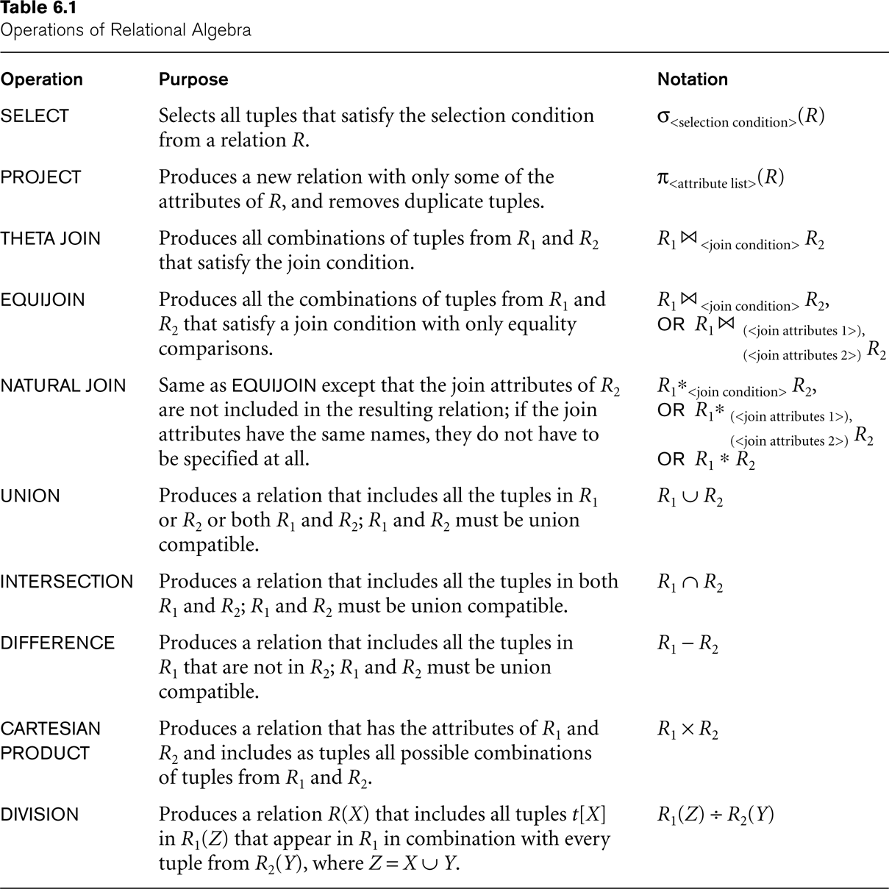
Summary of Operations

Slide 4
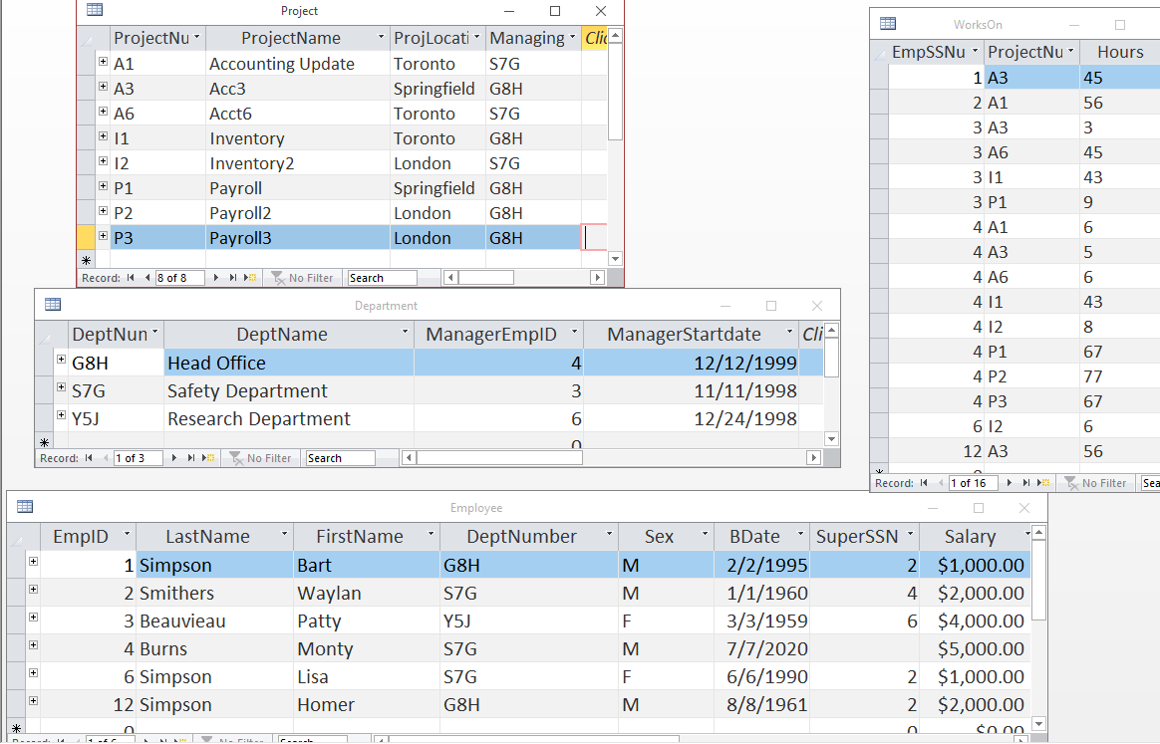
Final Review Questions
QUESTION: Write the expression to find all the employees last names and salaries who work in Head Office
QUESTION: Write the expression to list the name of each project, along with the name of the department it is assigned to, along with that department managers last name.
HEADOFF1 ← _{π DeptNumber}(_{σdeptName=“Head Office”}(DEPARTMENT))
ANS← _{π LastName,Salary}(HEADOFF1 EMPLOYEE)
TEMP ← π DeptName, ManagerEmpID,ProjectName(DEPARTMENT _{DeptNumber=ManagingDeptNum} PROJECT)
ANS← π LastName, DeptName, ProjectName(TEMP _{ManagerEmpID=EmpID} EMPLOYEE)

Slide 5
QUESTION: Retrieve the names of employees who have no dependents.
ALL_EMPS ← _{π EmpID}(EMPLOYEE)
EMPS_WITH_DEPS(EmpID) ← _{π ESSN}(DEPENDENT)
EMPS_WITHOUT_DEPS ← (ALL_EMPS - EMPS_WITH_DEPS)
RESULT ← π LNAME, FNAME (EMPS_WITHOUT_DEPS EMPLOYEE)

Slide 6
Use the following two tables to answer the following questions:
Table AA:
Table BB:
A | B | C | D
2 | 22 | y | z
2 | 33 | x | x
1 | 22 | x | y
1 | 11 | w | x
E | F | D
1 | 44 | z
2 | 44 | x
2 | 33 | x

Slide 7
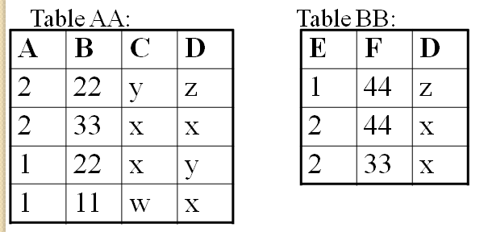
QUESTION: How many attributes will the following query return?
AA BB
QUESTION: How many tuples? List those tuples:
A | B | C | D | E | F
2 | 22 | y | z | 1 | 44
2 | 33 | x | x | 2 | 44
2 | 33 | x | x | 2 | 33
1 | 11 | w | x | 2 | 44
1 | 11 | w | x | 2 | 33

Slide 8
QUESTION: How many attributes will the following query return?
AA _{C=D}BB
QUESTION: How many tuples? List those tuples:
A | B | C | AA.D | E | F | BB.D
2 | 33 | x | x | 2 | 44 | X
2 | 33 | x | x | 2 | 33 | X
1 | 22 | x | y | 2 | 44 | X
1 | 22 | x | y | 2 | 33 | X

Slide 9
QUESTION: How many attributes will the following query return?
AA BB
QUESTION: How many tuples? List those tuples:
A | B | C | D | E | F
2 | 22 | y | z | 1 | 44
2 | 33 | x | x | 2 | 44
2 | 33 | x | x | 2 | 33
1 | 11 | w | x | 2 | 44
1 | 11 | w | x | 2 | 33

Slide 10
QUESTION: How many attributes will the following query return?
AA BB
QUESTION: How many tuples? List those tuples:
A | B | C | D | E | F
2 | 22 | y | z | 1 | 44
2 | 33 | x | x | 2 | 44
2 | 33 | x | x | 2 | 33
1 | 11 | w | x | 2 | 44
1 | 11 | w | x | 2 | 33
1 | 22 | x | y | NULL | NULL

Slide 11
QUESTION: How many attributes will the following query return?
AA BB
QUESTION: How many tuples? List those tuples:
A | B | C | D | E | F
2 | 22 | y | z | 1 | 44
2 | 33 | x | x | 2 | 44
2 | 33 | x | x | 2 | 33
1 | 11 | w | x | 2 | 44
1 | 11 | w | x | 2 | 33
1 | 22 | x | y | NULL | NULL

Slide 12
QUESTION: How many attributes will the following query return?
π _{D} (AA) ∩ π _{D} (BB)
QUESTION: How many tuples? List those tuples:
D
z
x

Slide 13
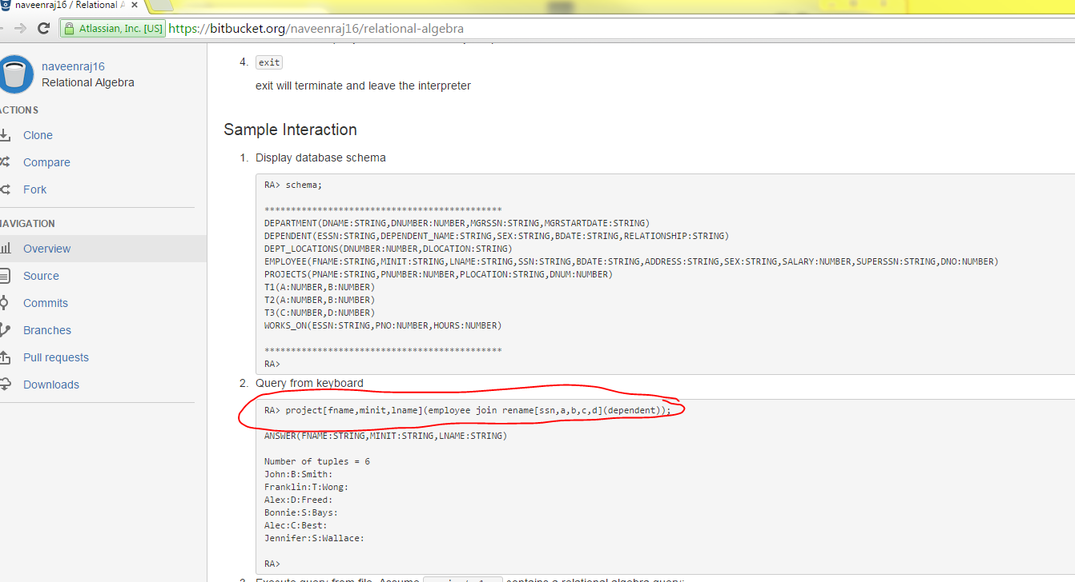
Interesting Project – Relational Algebra Interpreter
Website: https://bitbucket.org/naveenraj16/relational-algebra
“This open source project provides an implementation of a relational algebra interpreter. This is a useful tool in introductory database courses where querying through relational algebra is covered. The interpreter assumes a MySQL database. The relational algebra queries are executed over the tables of the MySQL database.”

